Slide 1
AR communication – Development

Slide 2
AR Roles
Primary Role
Touch and Touch in goal
Know your touch laws well! (video)
Secondary Role
Foul play
Other roles
Positioning
Lead and Trail
Kick in General play
Goal kick

Slide 3
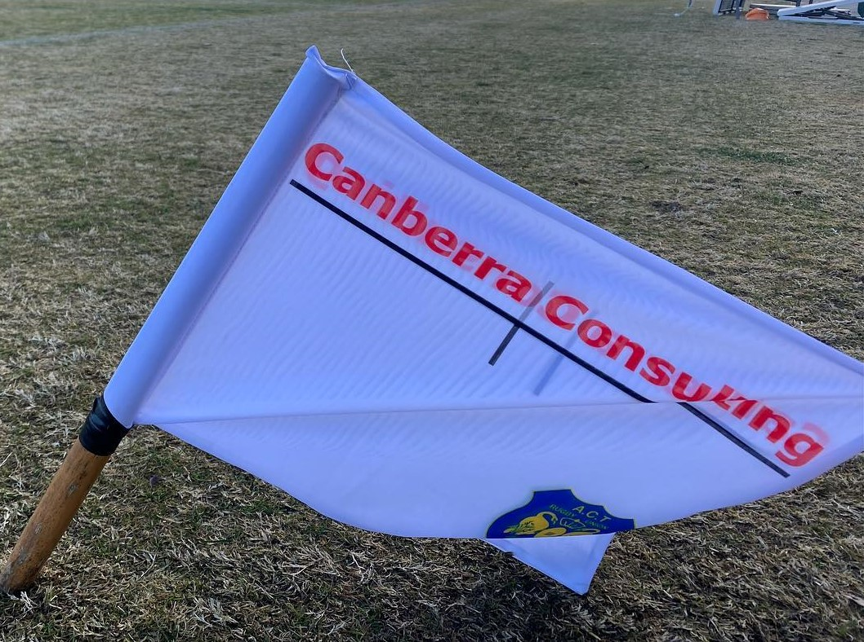
TRM – Trail/Lead

Slide 4
TRM – Trail/Lead (Goal Line)

Slide 5
TRM – Trail/Lead (Goal Line - exit)

Slide 6
Scrum – Trail/Lead

Slide 7
AR General verbals (with radio comms)
Be calm – you don’t have to rush it, shout or panic.
Slow/Clear
Brief/direct wording (less words!)
Call in only when “Clear and Obvious” (and it had a material effect) – and try to have player number identified.
When it requires the referee to PK
Colour/Colour /Colour. Whistle blows. Then “colour & number, offence”
Offence = use LAW speak
When referee is able to manage or there’s opportunity for advantage
Not a material offence/game Information for awareness. Eg Space is tight around pillar/posts, backs at scrum/LO coming up early
Can be more casual
Foul Play: “I have (serious) foul play report against red”

Slide 8
Examples
Ruck infringement
Scrum offside
Lineout offside
Scrum penalty
The Good
The Bad
And the………good

Slide 9
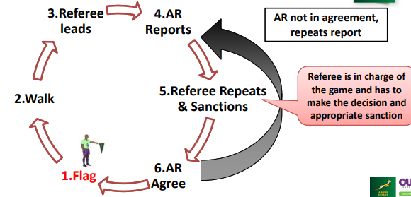
Foul play report - Communication Process
Start at the Flag:
Referee leads the conversation
AR reports the incident to the referee (paint the correct picture)
Referee repeats the information followed by a sanction
AR listens to the information and agree to the accuracy
Repeat the conversation in the event of a misunderstanding

Slide 10
Communication Process
WHEN called by the referee, walk onto the playing area
Formulate the incident as follows (Be precise):
WHO – infringed
Use jersey number & colour or look for something distinctive i.e. boots, strapping, headgear, or even the player’s name
WHAT – transpired
All the facts at hand
Only what’s clear and obvious
Use Law terminology
WHERE - the incident occurred (field location)

Slide 11
Foul play reports - examples
High tackle – high impact
Punches in back play

Slide 12
Uni Norths were in possession and moving towards the Gungahlin Eagles try line. A group of Uni Norths and Gungahlin Eagles players were engaging in some push and shove, in back play, and during this push and shove the offending player, No 2 for Gungahlin Eagles, punched No 14 (wearing blue and pink headgear) of Uni Norths in the head. Note that this incident occurred as Uni Norths scored and the Referee and other Assistant Referee did not see the reported foul play. Force of the punch was Low and impact of the punch on No 14 Uni Norths was also Low - he was coherent and able to continue playing following the punch. Another player (No 19), for the Gungahlin Eagles, also punched No 14 for Uni Norths in the head, during this incident, and that foul play will be reported separately. I spoke to the group of players, during the incident, and following the two separate punches the players dispersed. I then reported the two separate punches to the Referee and he awarded two separate Red Cards. Hudl/Bar TV video footage of the match does NOT show the two separate punches – see footage from the 55.50 minute mark. I showed the Referee, Mitch Egan, this Red Card report prior to uploading it and he was fully supportive of my report - he planned to acknowledge this when submitting his corresponding Red Card report(s).
2nd report same as first – swap red for No.19 and No2 respectively.
1 pleaded guilty – 3 weeks
2 pleaded “Didn’t do it” – got off. Judiciary felt no evidence to convict.

Slide 13
Questions?

